Slide 1

CRIME INCIDENTS 2012-2014
Data Science Project
Yvonne

Slide 2
Introduction and Background:
The Nationwide Crack epidemic in the 80’s and 90’s effected DC’S Crime Rate as well. Columbian drug cartels smuggled Crack into DC and in the early 90’s DC’s Crime Rate peaked at its highest at this time, especially Homicide and DC was known as the ‘murder capital’ of the United States.
According to Wikipedia crime rate dropped in Washington DC in the mid 2000 to their lowest level in over 20 years. Crime still remains a significant factor in DC
In 2012 crime rate in itself started to rise again while the murder rate surprisingly dropped.

Slide 3
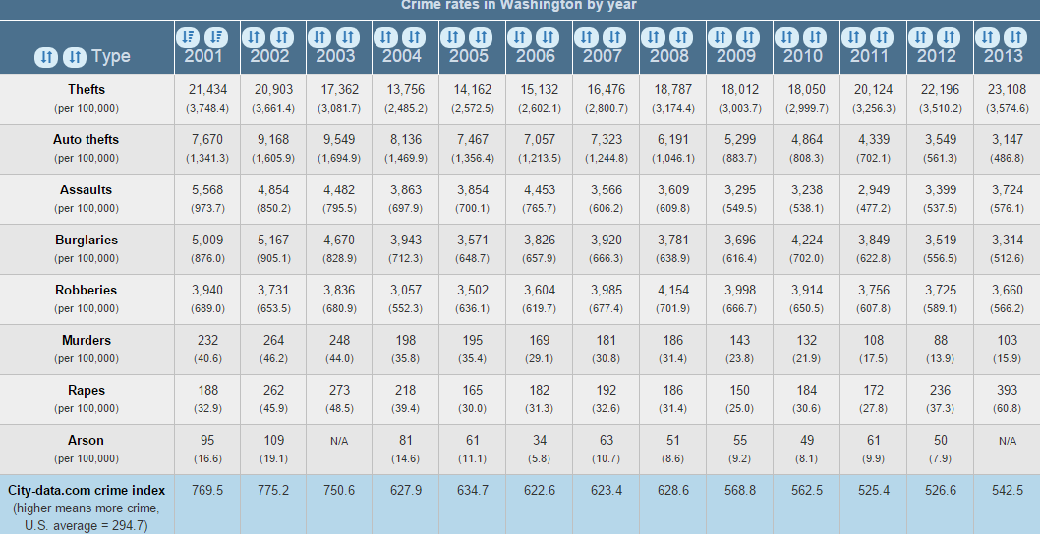
DC has been for many years above the average U.S. Crime Rate
Source: City-data.com

Slide 4
QUESTION:
IS IT POSSIBLE TO PREDICT CRIME RATE FOR 2015 IN DC?

Slide 5
DATA HAS BEEN GATHERED FROM:
Crime Incidents 2012
Crime Incidents 2013
Crime Incidents 2014
These 3 datasets can be found through OCTO (download into a csv)
Employment Information 2012
Employment Information 2013
Employment information 2014
Dataset can be found at DOES.
Fahrenheit by day 2012
Fahrenheit by day 2013
Fahrenheit by day 2014
Data has been collected from Dhttp://w2.weather.gov/.

Slide 6
Data Structure:
Crime Data 2012-2014
Employment 2012-2014
Temperature 2012-2014
CCN
REPORTDATETime
SHIFT
OFFENSE/METHODE
LASTMODIFIEDDATE
BLOCKSITEADDRESS
BLOCKXCOORD
BLOCKYCOORD
WARD
ANC
DISTRICT
PSA
NEIGHBORHOODCLUSTER
BUSINESSIMPROVEMENTDISTRICT
BLOCK_GROUP
CENSUS_TRACT
VOTING_PRECINCT
START_DATE
ESRI_OID
END_DATE
Ward
LaborForce
Employment
Unemployment
Rate
Month
YEAR
Day
Jan
Feb
Mar
Apr
May
June
July
Aug
Sept
Oct
Nov
Dec
YEAR

Slide 7
DATA CLEANING AND EXPLORATION
Imported the Crime Incidents data
Since the date was in y/m/d/t, I split the column to just the year as well as m/d/y.
I renamed the column that I know I want to work with.
I combined the Crime_Incident 2012, 2013 and 2014
All 3 Employment data sets were combines
Pulled the temperature data for 2012-2014, added a field that combined m/d/y
I joined all fines on the m/d/y criteria and on the ward
Surprisingly Ward 4 had an increase over 700 crime incidents from 2012 to 2014, while Ward 8 crime incidents went down
It appears that the evening shift has a higher crime rate, you can also see that the crime rate increased from 2012 to 2014

Slide 8
CRIME INCIDENTS BY WARD PER YEAR
WARD | 2012 | 2013 | 2014
1 | 5058 | 5407 | 5408
2 | 6537 | 5950 | 6775
3 | 1781 | 1934 | 1824
4 | 3001 | 3262 | 3796
5 | 4795 | 4611 | 5379
6 | 5512 | 5669 | 6023
7 | 4344 | 4613 | 5108
8 | 4398 | 4433 | 4074

Slide 9
CRIME INCIDENTS IN A SHIFT PER YEAR
SHIFT | 2012 | 2013 | 2104
Evening | 14686 | 15154 | 16279
Day | 14436 | 14092 | 15248
Midnight | 6307 | 6636 | 6861

Slide 10
Crime Offenses in a Year
OFFENSE | 2012 | 2013 | 2014
THEFT/OTHER | 12480 | 12888 | 14628
THEFT F/AUTO | 9463 | 10131 | 11285
ROBBERY | 4268 | 4071 | 3333
BURGLARY | 3680 | 3369 | 3184
MOTOR VEHICLE THEFT | 2863 | 2675 | 3119
ASSAULT W/DANGEROUS WEAPON | 2295 | 2310 | 2398
SEX ABUSE | 257 | 299 | 309
HOMICIDE | 88 | 104 | 106
ARSON | 35 | 35 | 26

Slide 11
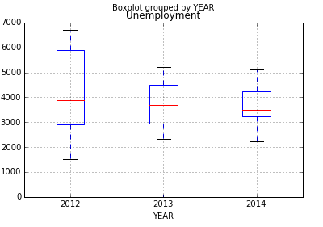
UNEMPLOYMENT RATE BY YEAR

Slide 12
Insight which has been gained after looking into the DATA
After playing around with the employment data I came to the surprising conclusion that employment does not appear to play a role in Crime. In 2014, the rate of theft was at 14628 which is the highest in all 3 years while unemployment was at its lowest in that timeframe. It brings the question if more years have to be collected of the employment data to see if there maybe is a relationship between people recovering from unemployment over the years and that’s why the crime is way up even though there is low unemployment rate.
It also appears that NW neighborhoods which tend to be more affluent, draw more tourist and have a more vibrant nightlife appear to have a higher CrimeRate. Violent crime also remains a problem in ward 8, which has the highest concentration of poverty.

Slide 13
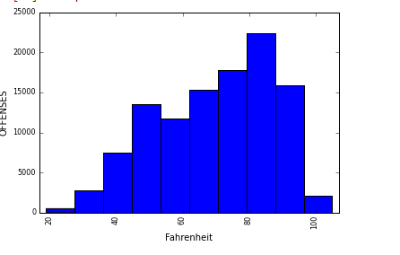
OFFENSE BY FAHRENHEIT
Looking a little further into how temperature actually compares to the quantity of the crimes – it shows that between 80
-91degrees is a higher Crime Rate

Slide 14
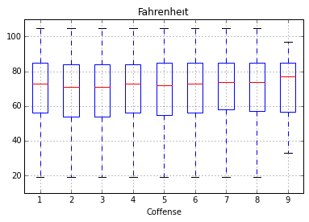
Offense compared with Temperature
Legend:
1 = THEFT/OTHER
2 = THEFT F/AUTO
3 = ROBBERY
4 = BURGLARY
5 = 'MOTOR VEHICLE THEFT
6 = ASSAULT W/DANGEROUS WEAPON
7 = SEX ABUSE
8 = HOMICIDE
9 = ARSON

Slide 15
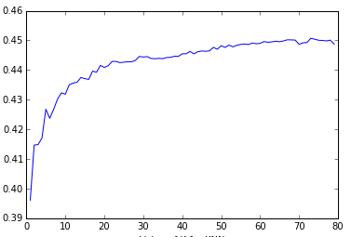
After the low score from the linear regression I tried to move on with a Kfold – which didn’t give me a higher score either

Slide 16

Predictions:
I tried linear regression which only gave me a 47% accuracy
Cross validation with [Offense] as the Target gave me the same result
I switched the Target to the [Shifts] which reduced the accuracy to 46%
Running a Kfold with the Target being the [WARD ] and my features being [Fahrenheit],[shift],[offense],[BLOCKXCOORD],[BLOCKYCOORD],[year], I received a 98% accuracy return.
This answer wasn’t good enough and I have a feeling it is incorrect, so I tried the regression tree
The regression tree did not want to cooperate with me and I failed trying

Slide 17

Next Steps:
Unfortunately I ran out of time.
I tried to gather data about the Wards demographics like:
- marital status
- race/ethnicity
- income
- education
- average age, etc
The challenge is to stay focused, the more answers you get from the data the more questions come up which could have an impact on Crime. It seems like a bottomless pit of possibilities that could be explored.

